Slide 1
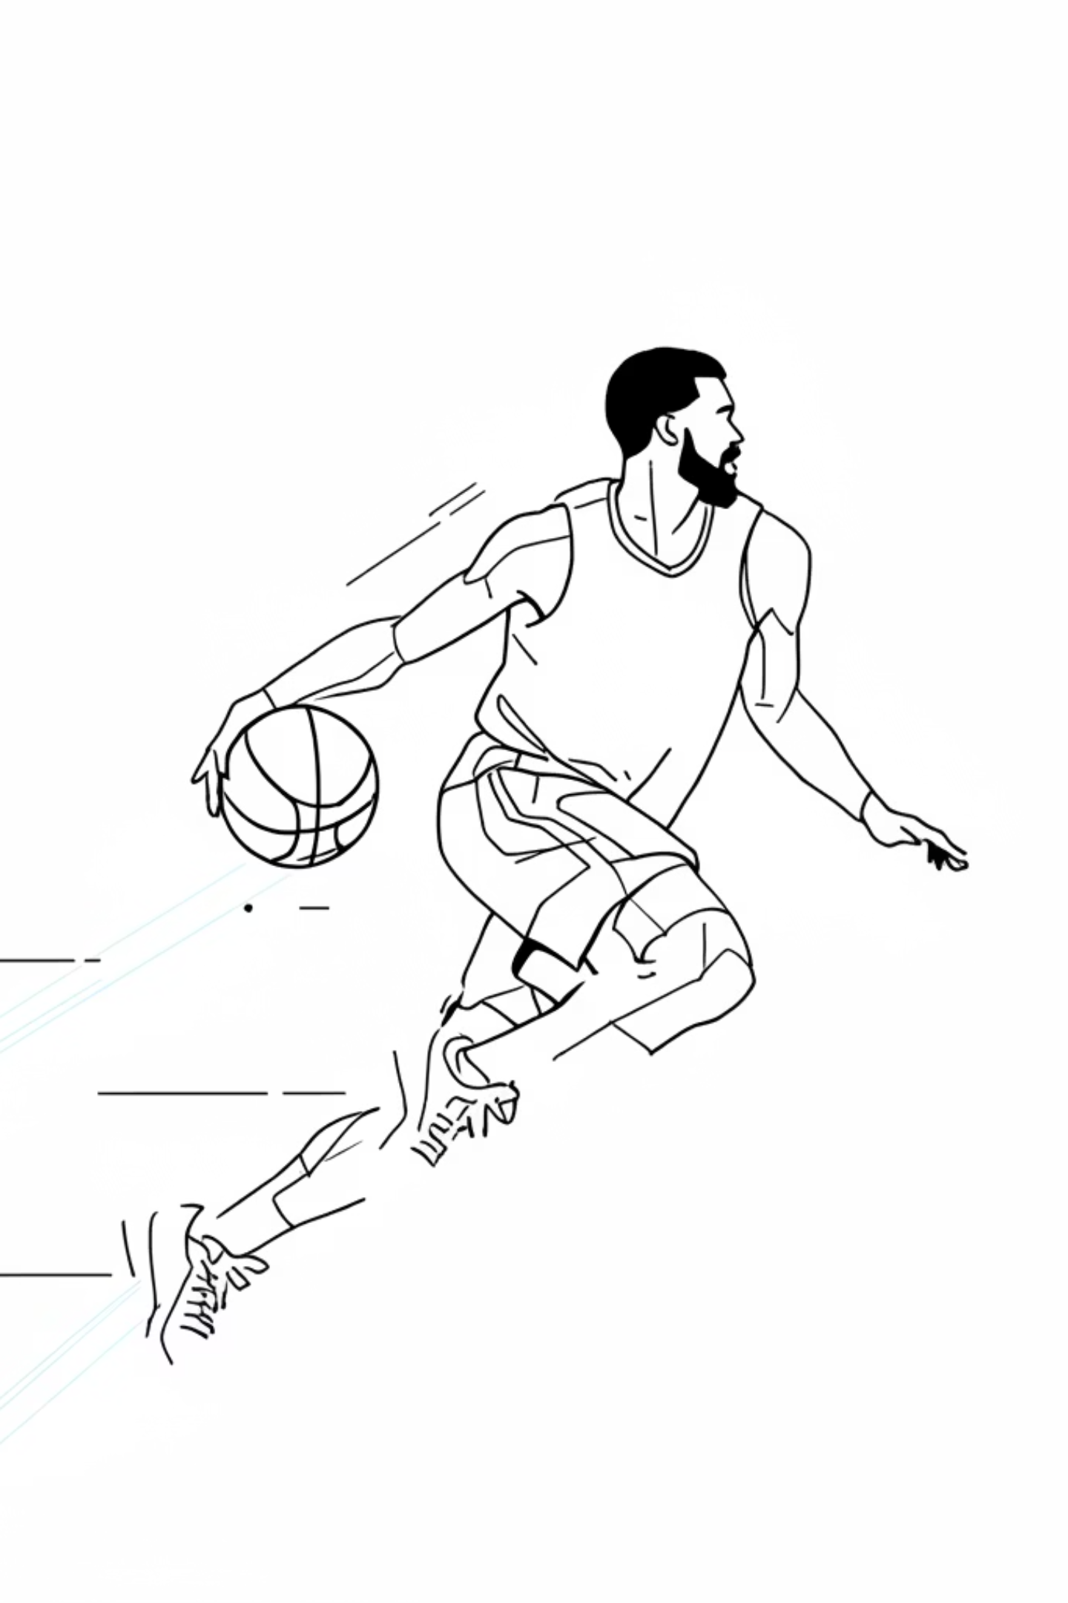
Computer Vision Analysis of Basketball
Analyzing broadcast basketball videos is a major challenge in computer vision due to rapid movements, frequent camera changes, and occlusions.

Slide 2

Video Analysis Challenges
Rapid Movements
Camera Changes
Players move quickly, making detection and tracking difficult.
Frequent camera transitions complicate continuous object tracking.
Ball Detection
Crowded Scenes
The small, fast ball is often missed by traditional detectors.
Frequent occlusions between players make individual identification complex.

Slide 3
Basketball Detection System
Player, Hoop & Ball Detection
Deepsort Tracking
Ball Trajectory Estimation
Team Detection
Court Segmentation and Homography
Ball Possession Estimation

Slide 4
Model Performance Metrics
Player Detection Model
Ball & Hoop Detection
Trained on 2,021 images for robust player detection.
Optimized for small objects using 533 training images.
92.79%
89.76%
89.9%
77.64%
Precision
Recall
Precision
Recall
92.96%
86.08%
mAP@0.5
mAP@0.5

Slide 5
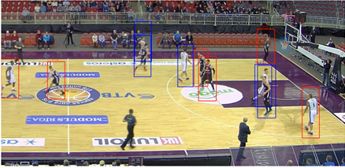
DeepSORT Tracking Integration
DeepSORT ensures consistent player identities by combining appearance features with motion prediction, minimizing identity switches.
Motion Model
Appearance Features
Kalman filter for motion prediction
Deep CNN for visual similarity
Association Metric
Weighted motion and appearance

Slide 6



Ball Trajectory Post-Processing
Compensating for Imperfect Detections
Initial Approach
Challenges
Final Solution
Physics-inspired parabolic trajectory
Unreliable in practice
Interpolation-based strategy
Camera motion effects
Frame buffering
Linear horizontal motion
Perspective distortions
Linear interpolation
Quadratic vertical motion
Occlusions and noise
Red ball markers
Least-squares fitting

Slide 7
Interpolation-Based Gap Filling
How It Works
Key Advantages
01
No Physical Assumptions
Buffer Frames
Avoids unreliable projectile models
Temporarily hold frames when ball not detected
02
Stable & Consistent
Linear Interpolation
Smooth visual representation
Calculate positions between last and next detection
03
Explicit Failures
Draw Markers
Makes detection gaps visible
Red ball markers create smooth trajectory
04
Visual Fallback
Last valid bounding box persists briefly

Slide 8
Team Detection Evolution
Three Approaches Explored
Edge-Based Segmentation
SigLIP Embeddings
Method: Canny edge detection + morphological operations
Method: Visual embeddings + UMAP + K-Means clustering
Result: Unreliable - weak edges, background interference
Result: Robust semantic features, stable team separation
Status: Discarded
Status: Final Approach
1
2
3
GrabCut + Color Clustering
Method: GrabCut segmentation + LAB color space + K-means
Result: Promising with ground truth, failed with noisy detections
Status: Discarded

Slide 9
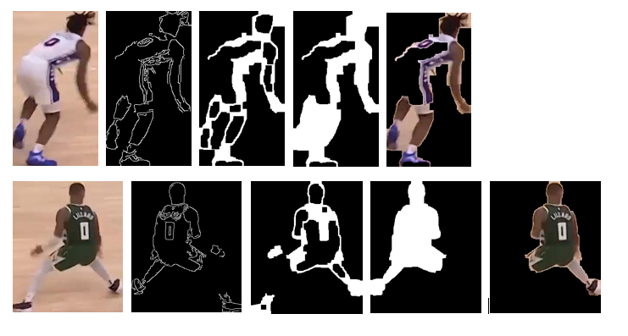
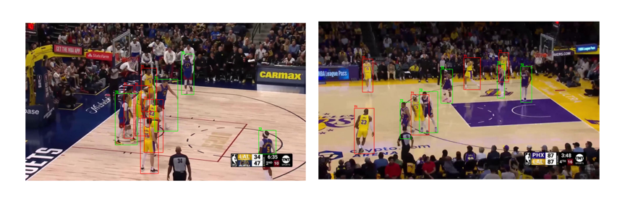

Slide 10

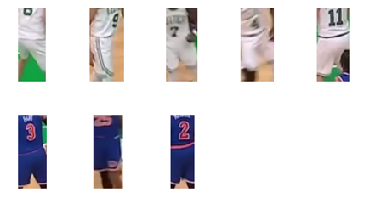
SigLIP-Based Team Clustering
Pipeline Architecture
Why It Works
Player Crop Collection
Relies on strong semantic visual features beyond raw color
YOLO detection every 30 frames, shrink boxes by 0.4x to focus on jerseys
Robustness
No pixel-level masks required - handles noisy detections
Feature Extraction
Pre-trained SigLIP vision backbone produces high-dimensional embeddings
Stability
More consistent than segmentation-based methods
Dimensionality Reduction
UMAP projects features to 3D space, reducing noise
Team Assignment
K-Means (K=2) clusters players into two teams

Slide 11
Court Segmentation Approaches
1
2
3
Color-Based Region Growing
Scanline Analysis
Connected Components + Convex Hull
Method: Row-by-row processing, chroma smoothness, dominant color histogram
Method: Lab color space, seed pixels from bottom-central region, iterative neighbor addition
Method: Largest component extraction, convex hull approximation, geometric refinement
Limitations: Sensitive to lighting, shadows, reflections - inconsistent quality
Limitations: Lighting variations, shadows, court markings caused leakage and incomplete coverage
Limitations: Overfilled boundaries, failed with perspective distortions
Status: Exploratory
Status: Not sufficient alone
Status: Not retained

Slide 12
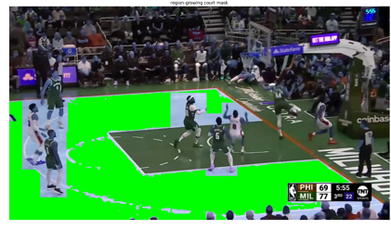
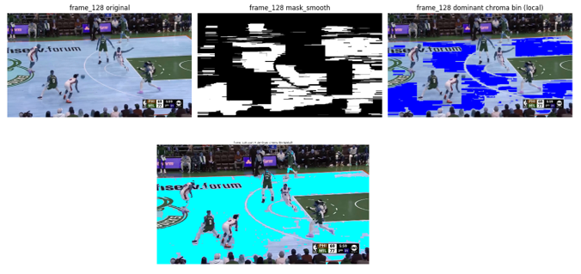
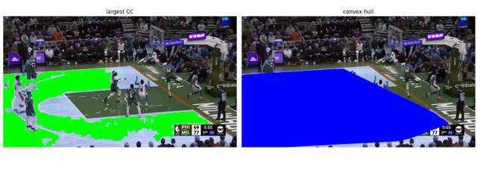

Slide 13

Court Homography & Player Mapping
Manual Correspondence Approach
Automatic methods proved unreliable under broadcast conditions
1
Point Selection
Stability
Manual correspondences between frame and court template
Significantly more reliable than automatic detection
2
Homography Estimation
RANSAC-based method reduces noise sensitivity
Consistent Mapping
3
Player Projection
Enables spatial tracking across frames
Bottom-center of bounding box as ground contact point
4
Top-Down Visualization
Transform via homography to court template
Visual Analytics
Team occupancy and movement visualization
Court template sourced from open-source basketball analysis repository by Tarek

Slide 14
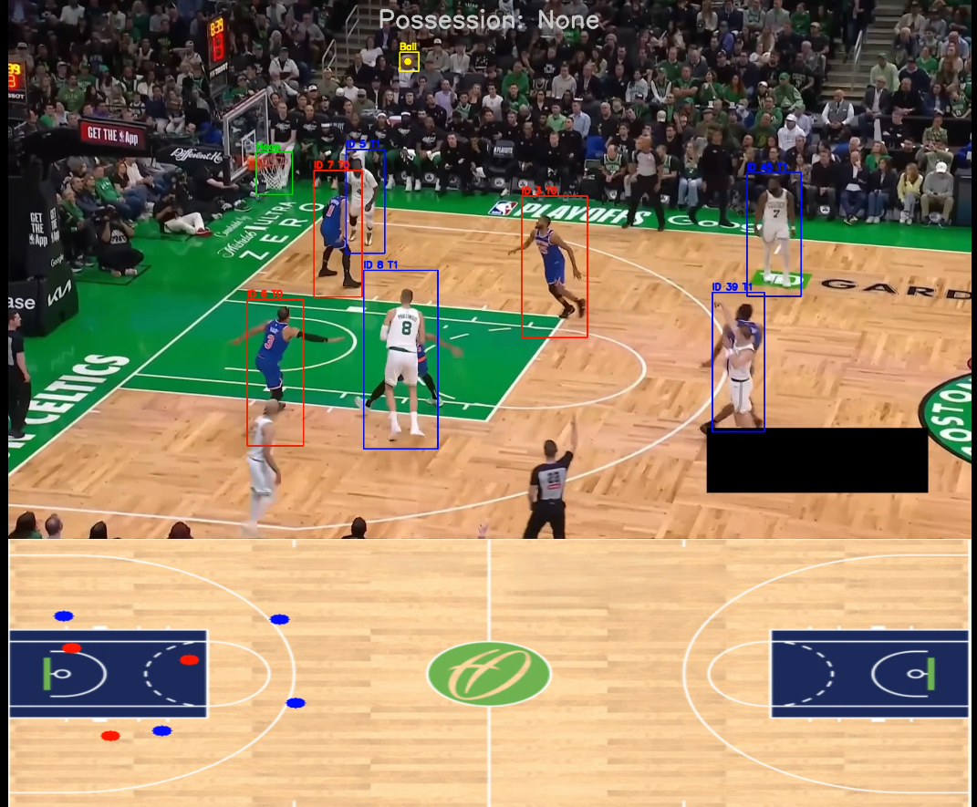

Slide 15
Ball Possession Estimation
Spatial & Temporal Logic
Mitigates Noise
01
Reduces rapid fluctuations from detection errors
Overlap Detection
Compare ball bounding box against all player boxes
Handles Occlusions
02
Brief ball disappearances don't disrupt tracking
Possession Assignment
Player with >0.6 overlap fraction controls ball
Visual Stability
03
Color-coded labels provide intuitive representation
Team Inference
Use controlling player's team label
No Learning Required
Purely spatial and temporal information
04
Temporal Cooldown
Change accepted only if persistent across minimum frames

Slide 16
Limitations & Future Directions
Dataset Scale
Video Quality Robustness
Advanced Segmentation
Small specialized datasets limit generalization. Need larger, more diverse basketball datasets across broadcast environments, lighting, and venues.
Pipeline lacks adaptability to varying resolution, aspect ratios, compression. Requires preprocessing strategies or adaptive architectures.
Foundation models like SAM2 could provide robust semantic segmentation, replacing hand-crafted heuristics for court and player masks.
3D Ball Tracking
Court Homography
Current 2D tracking needs depth perception for physically accurate trajectories. Requires stereo vision or monocular depth estimation.
YOLO-based keypoint detection for court markings could enable robust automatic homography estimation, replacing manual initialization.

